Slide 1

Surface Tension

Slide 2
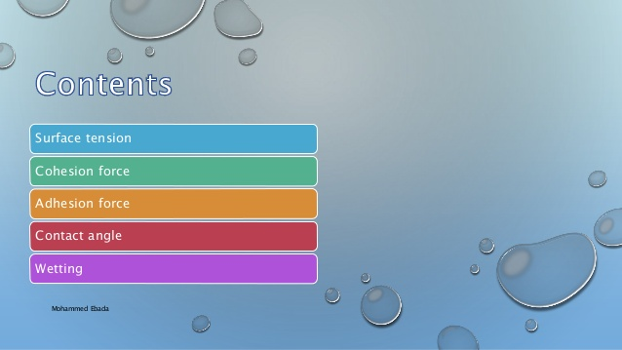

Slide 3
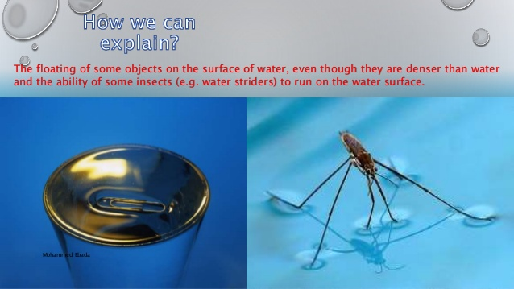

Slide 4
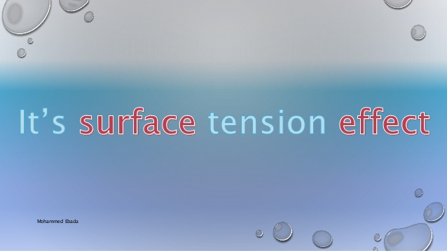

Slide 5
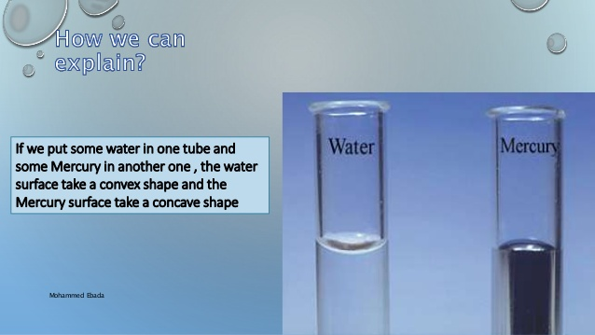

Slide 6


Slide 7
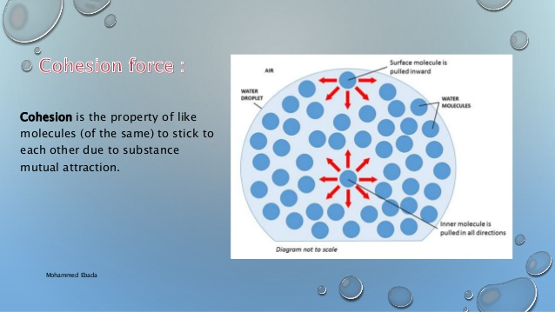

Slide 8
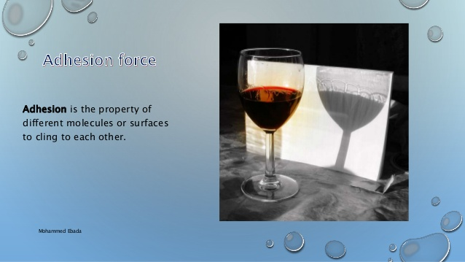

Slide 9
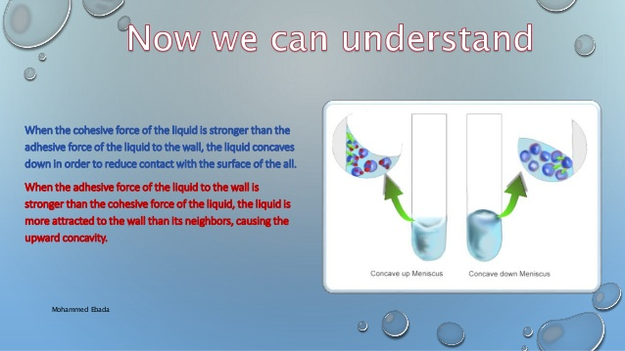

Slide 10
Surface Tension
A number of common observation suggest that the surface of a liquid acts like a stretched membrane under tension.
The surface of a liquid acts like it is under tension , and this tension , acting parallel to the surface arise from attractive force(قوة الجذب) between the molecules ,this effect called the “surface tension “

Slide 11

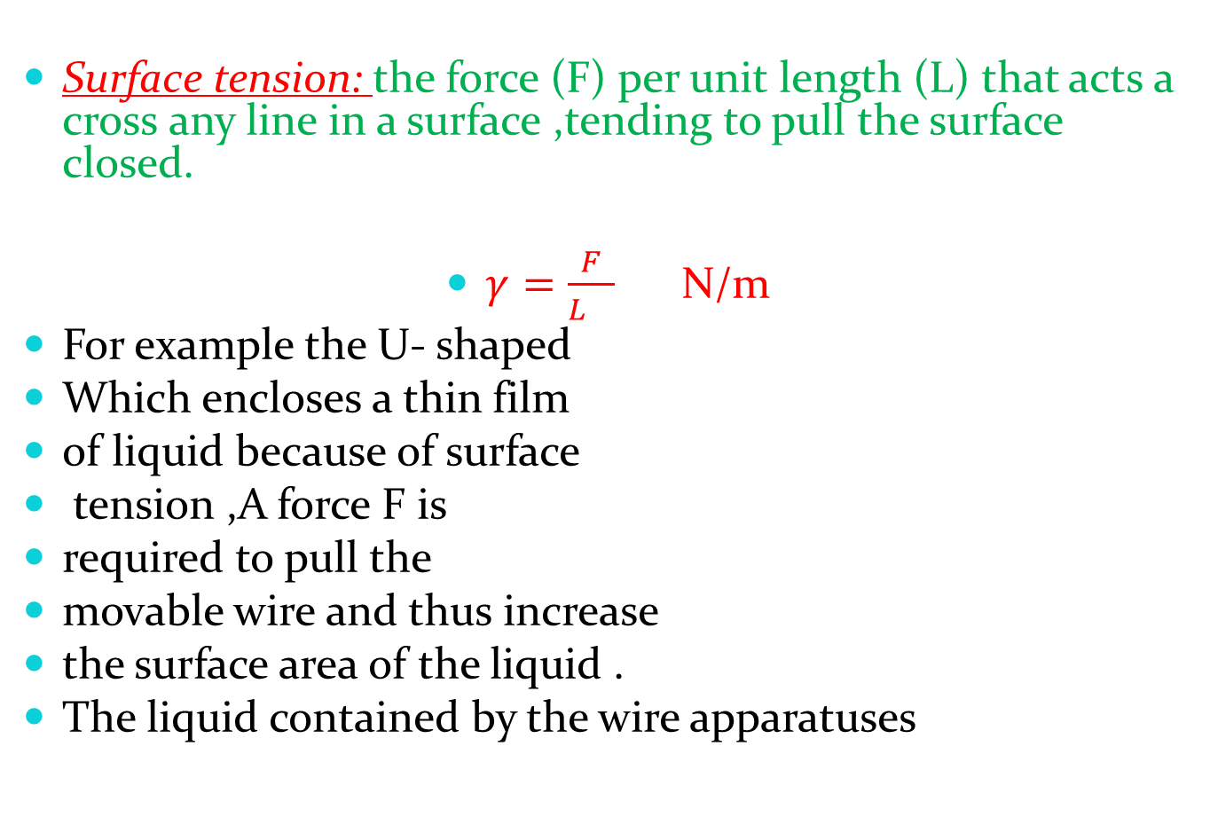
Surface tension: the force (F) per unit length (L) that acts a cross any line in a surface ,tending to pull the surface closed.
$γ=\frac{F}{L }$ N/m
For example the U- shaped
Which encloses a thin film
of liquid because of surface
tension ,A force F is
required to pull the
movable wire and thus increase
the surface area of the liquid .
The liquid contained by the wire apparatuses
A
A’
L
F
b
C
C’

Slide 12
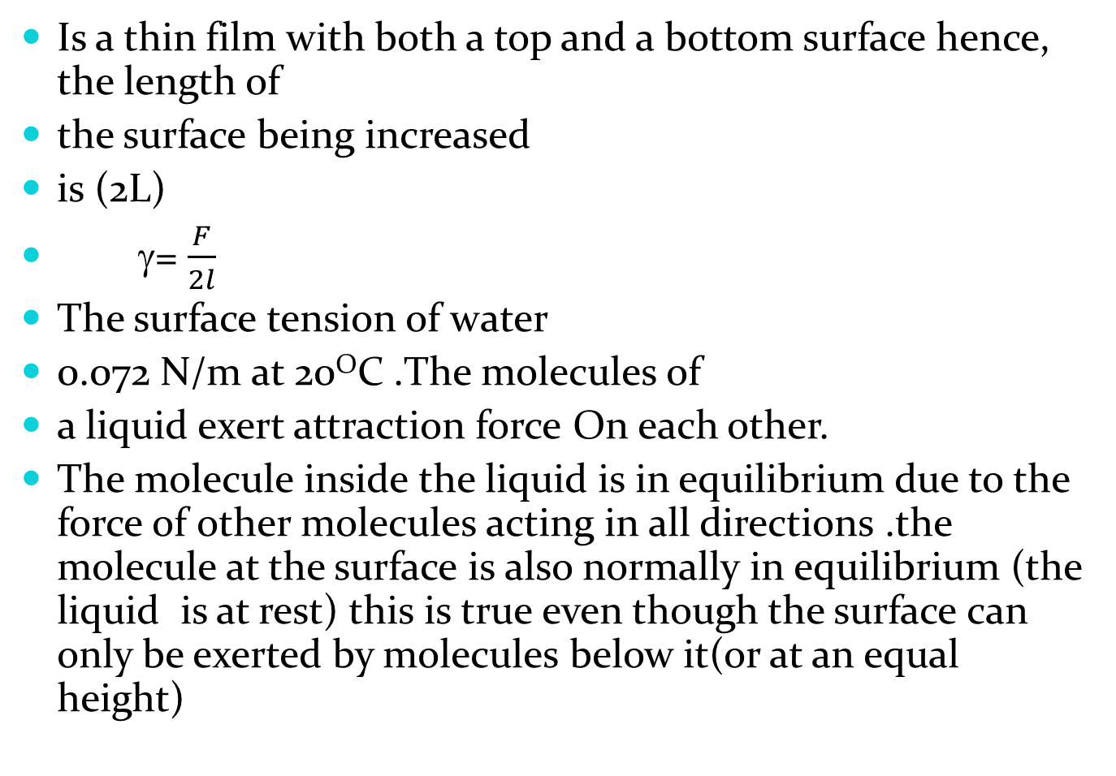
Is a thin film with both a top and a bottom surface hence, the length of
the surface being increased
is (2L)
γ= $\frac{F}{2l}$
The surface tension of water
0.072 N/m at 20^{O}C .The molecules of
a liquid exert attraction force On each other.
The molecule inside the liquid is in equilibrium due to the force of other molecules acting in all directions .the molecule at the surface is also normally in equilibrium (the liquid is at rest) this is true even though the surface can only be exerted by molecules below it(or at an equal height)
B
A

Slide 13
Hence: there is a net attractive force downward which tends to compress the surface layer slightly .but only to the point where this downward force is balanced by an upward (repulsive ) force due to close contact (or collision with )the molecules below .
This compression of the surface means that , in essence ,the liquid tries to minimize its surface ,this is why water tends to form spherical droplets ,for a sphere represents .the minimum possible surface area for a given volume .In order to increase the surface area of a liquid , a force is required and work must be done to bring molecules and is sometimes called surface energy .The greater the surface area energy.

Slide 14
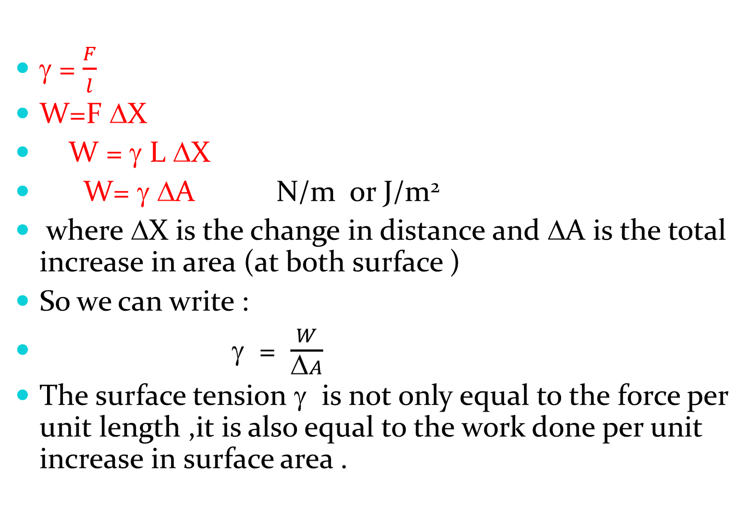
γ = $\frac{F}{l}$
W=F ΔX
W = γ L ΔX
W= γ ΔA N/m or J/m²
where ΔX is the change in distance and ΔA is the total increase in area (at both surface )
So we can write :
γ = $\frac{W}{\text{Δ}A}$
The surface tension γ is not only equal to the force per unit length ,it is also equal to the work done per unit increase in surface area .

Slide 15
If the object is spherical in the shape ,the surface tension acts at all points along a circle of radius ( r ) only the vertical component γcosθ ,acts to balance ( W ) .We set the length ( L ) equal to the circumference of the circle :
L=2πr So the net upward force due to surface tension is :
F= (γcosθ ) L
F = 2πr γ cosθ

Slide 16
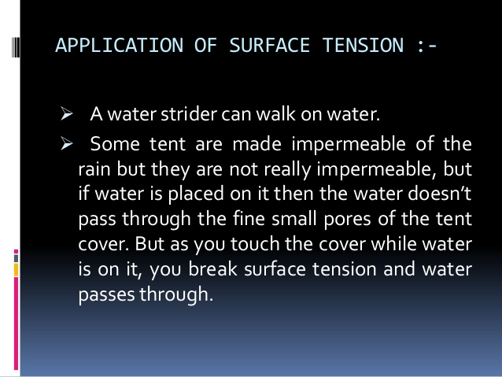

Slide 17
Example :
The base of an insect’s leg is approximately spherical in shape ,with a radius of about 2x10⁻⁵ m . The 0.003 g mass of the insect is supported equally by the six legs .calculate the angle θ for an insect on the surface of water .Assume the water temperature is 20ºC ?

Slide 18
Capillarity

Slide 19
Capillarity
Cohesion(التماسك) refers to the force between like molecule .
Adhesion(التلاصق) to the force between unlike molecule .
Water wet glass because the water molecules are more strongly attracted to the glass molecules than they are to other water molecules .
Angle of contact ( φ ) , is the angle that tangent to the liquid surface makes with the solid surface .
φ = cos⁻¹ [-γ_{s} / γ_{L}]
حيث γ_{L} هي التوتر السطحي بين سطح السائل والوسط المحيط بالسائل بينما γ_{s} هي التوتر السطحي بين سطح السائل وسطح المادة الصلبة.

Slide 20
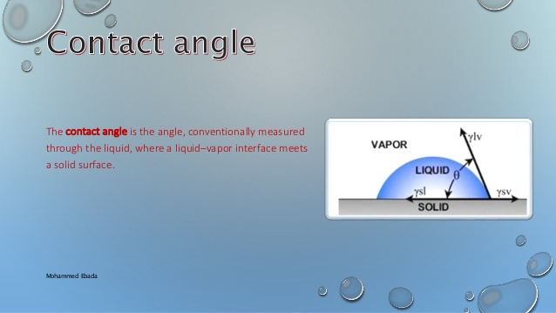

Slide 21
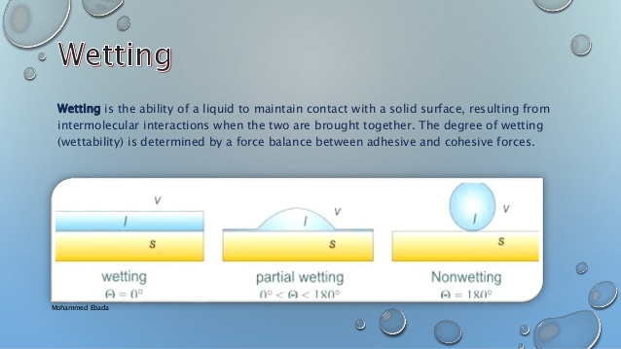

Slide 22
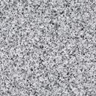
ملحوظة : زاوية التلامس تكون حادة إذا كانت قوى التلاصق أكبر من قوى التماسك. بينما تكون منفرجة إذا كانت قوى التلاصق أقل من قوى التماسك ).
φ < 90º the liquid wet the solid
φ > 90º the liquid doesn't wet the solid
l
θ
θ
ماء
زئبق

Slide 23
In tube having very small diameters ,liquids are observed to rise or fall relative to the level of the surrounding liquid .This phenomenon is called capillarity , and such thin tube called capillaries.
The height of liquid inside the capillary tube dependent on :
1- nature of liquids
2- radius of tube( h كلما قل القطر زاد الارتفاع)

Slide 24
The magnitude of the vertical force ( F ) due to surface tension is :
F= γ cosφ L
L = 2πr
F = 2πr γ cosφ
This force equal to weight of liquid downward.
V= π²r h the volume of tube
2πr γ cosφ =mg
2πr γ cosφ =(ρV)g
2πr γ cosφ = ρ πr² hg
Where ρ is the density of the liquid , So:
2 r
h

Slide 25
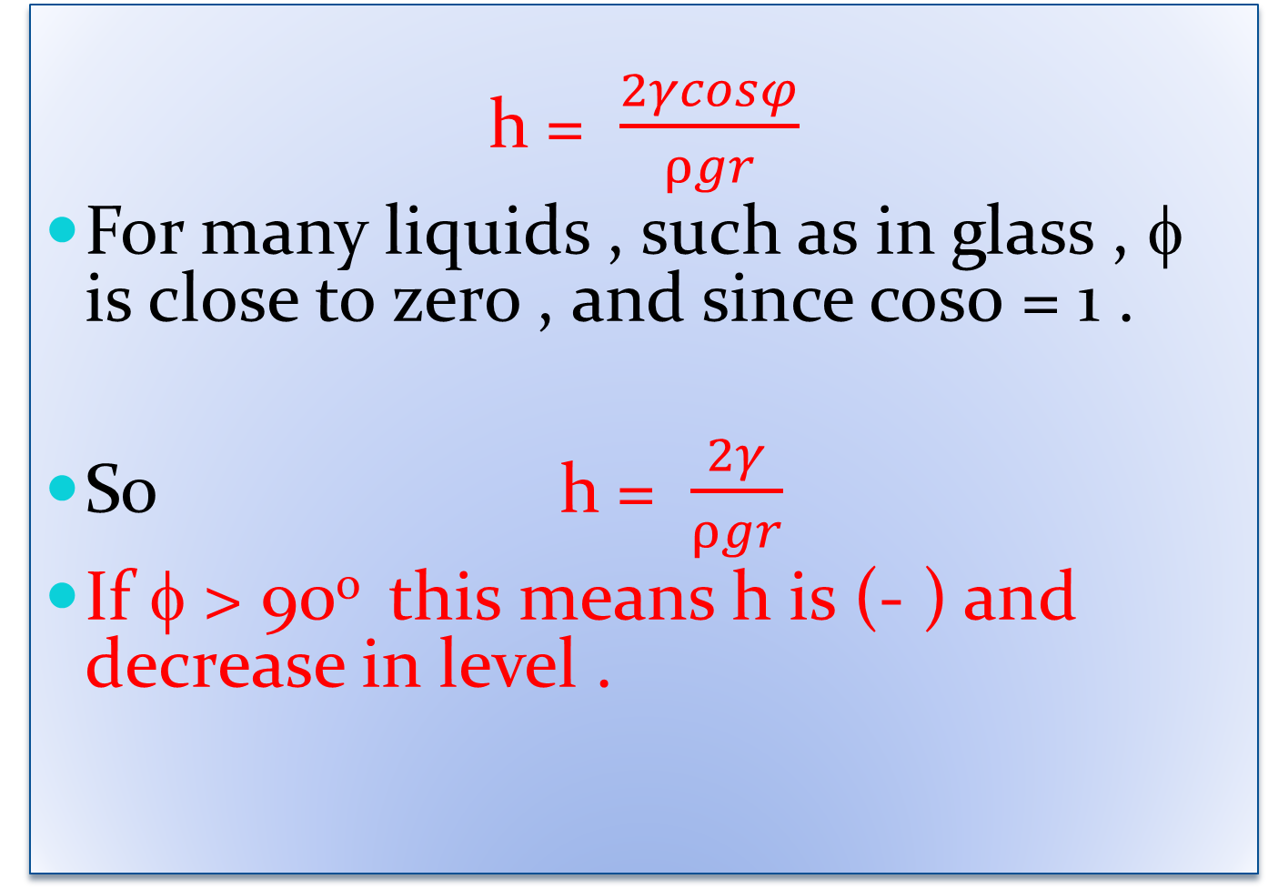
h = $\frac{2γcosφ}{ρgr}$
For many liquids , such as in glass , φ is close to zero , and since cos0 = 1 .
So h = $\frac{2γ}{ρgr}$
If φ > 90º this means h is (- ) and decrease in level .

Slide 26
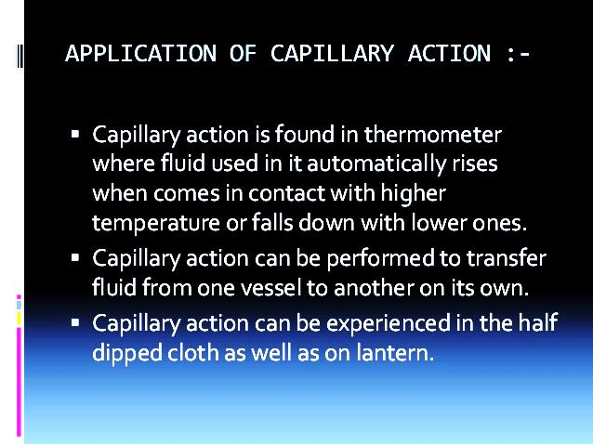

Slide 27
Example :
If the Xylem(خشب) ( tiny tube which plant has a radius of 0.001cm ,how high can we expect the surface tension to pull a column of water? Assume : φ = 0 , γ =0.072 N/m , ρ=1x10³Kg/m³ ,g = 9.8 m/s² .

Slide 28

Example:
A sample of chloroform rose to a height of 3.67 cm at 20°C in a capillary tube having an inside radius of 0.01 cm. What is the surface tension of chloroform at this temperature? The density of chloroform is 1.476 g/cm³.

